Slide 1

LIBRARY MANAGEMENT PROJECT
Team Members
Dev Agnihotri
Mohd. Talha
Project Name | Company Name | Presenter Name

Slide 2
Outline
Introduction
Project Overview
Library Operations
Security Authentication
Technology Stack
Conclusion

Slide 3

Section 1
Introduction

Slide 4
Revolutionizing Library Management with Technology
Modernizing Libraries: Creating a digital system to make libraries more efficient and user-friendly.
Easy Book Management: Making it simple for librarians to organize, find, and keep track of books and other materials.
Quick Access for Visitors: Helping people find the books they want faster and suggesting similar reads they might enjoy.
Enhanced Library Experience: Improving the experience for both librarians and visitors, making everything smoother and more enjoyable for everyone involved.

Slide 5

Section 2
Project Overview

Slide 6
Library Management System Overview
User-Friendly Interface: Creating a simple, easy-to-use system for librarians.
Integration for Efficiency: Integration ensures that information flows smoothly between different platforms, enhancing the accessibility and usability of library resources.
Operations Simplification: The primary aim is to simplify the day-to-day operations of libraries. The following book operations performed are:-
Adding ,Deleting ,book issue ,book return ,editing ,Searching and Showing all books
Databases: The library management system consist of the following 3 databases.
Admin Database, Student Database, Book Database

Slide 7
Error Handling:- When entering information, if something's not quite right (like a wrong book ID or an incomplete form), the system kindly points it out with clear messages. This way, librarians can easily spot and fix any mistakes, ensuring smooth operations without any confusion.
Ensuring Security and Scalability:- : Ensuring data safety while being adaptable for future growth.
Security is a top priority. The system incorporates robust measures to ensure that sensitive data remains protected. It contains a methods for authentication like a login form ,ensuring only admins are granted access
Additionally, it's built to grow with the library's needs, allowing for scalability and expansion as the collection and services evolve. It does not have a complex E-R Diagram ,making it easy to add new databases accordingly and a proper modeled code that make adding new operations(as buttons on GUI) simple.

Slide 8

Section 3
Library Operations

Slide 9
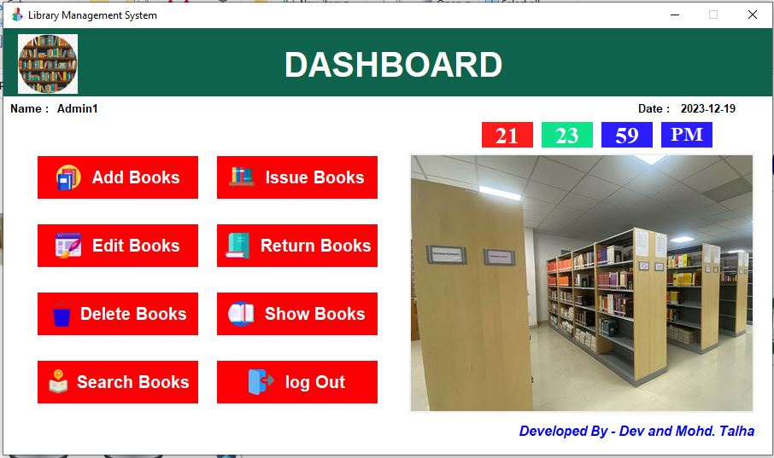
Individual Functionalities
The library Management system contains 8 buttons with individual functionalities.

Slide 10
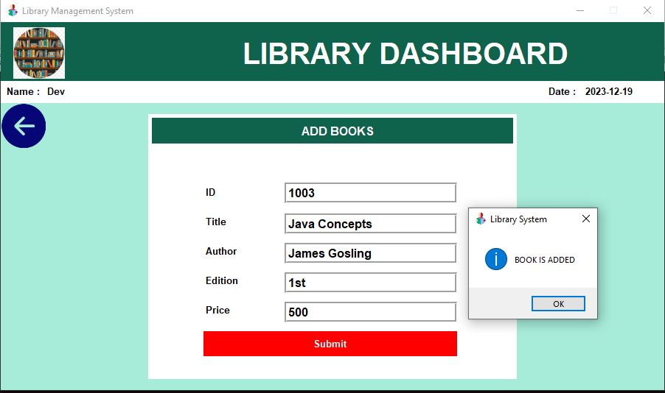
ADD BOOK
This operation is used to ADD a BOOK to the Library Management System(or Book Database). It consist of following feilds
ID, Title, Author, Edition, Price

Slide 11
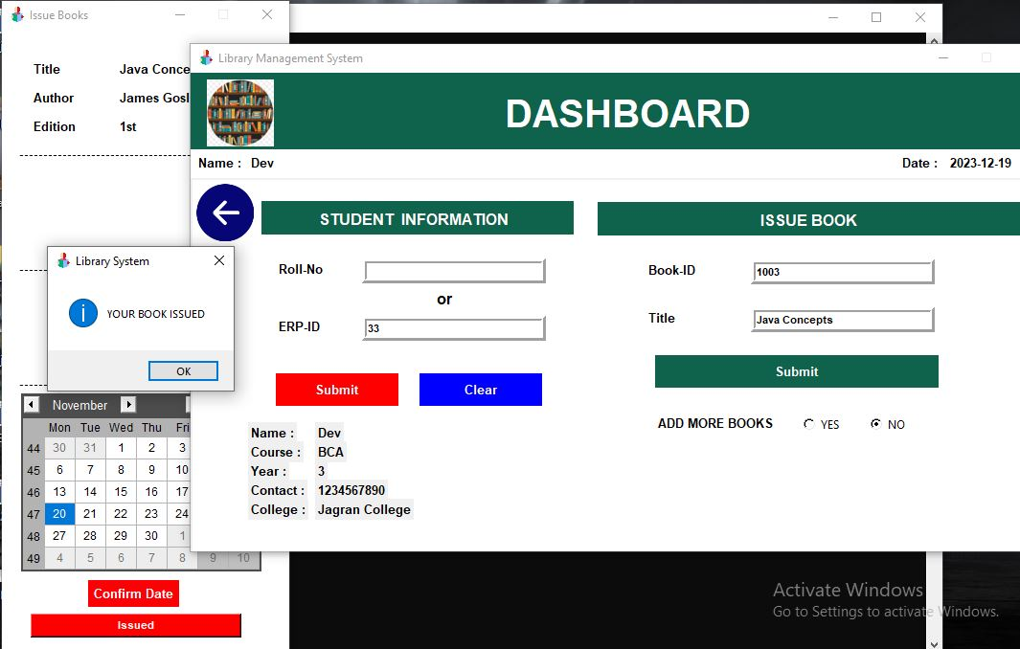
ISSUE BOOK
The issue book functionality empowers library patrons to effortlessly borrow materials, simplifying the checkout process for quick and convenient access to desired resources.

Slide 12
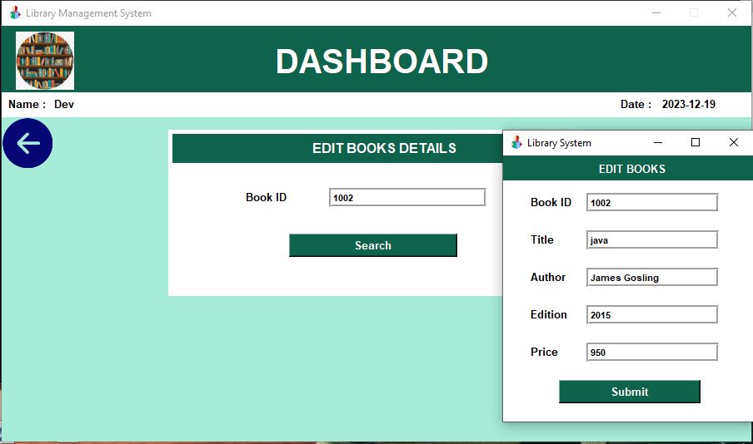
EDIT BOOK
The edit book feature allows librarians to easily update and modify book details, ensuring accurate and up-to-date information within the library system. It provides a streamlined way to make necessary changes, such as changing
Book ID, Title, Author, Edition, Price

Slide 13
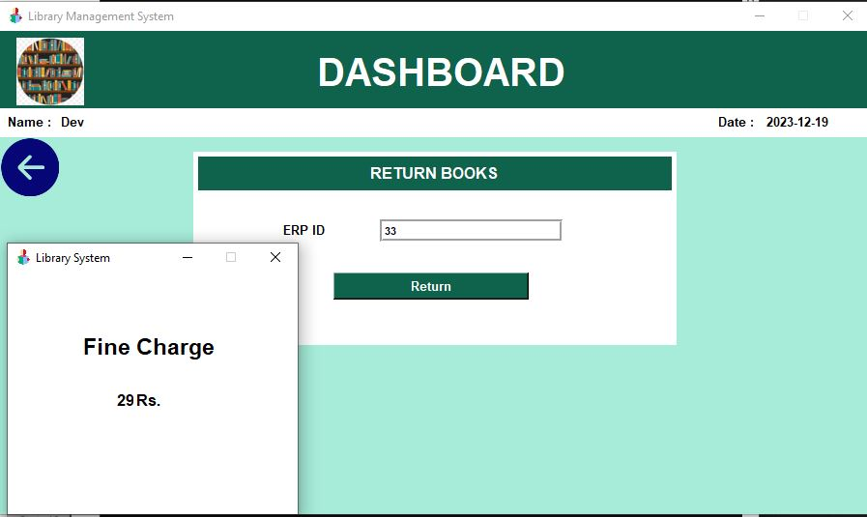
RETURN BOOK
The return book feature enables students to efficiently return borrowed books. Additionally, it manages fine charges, automatically calculating and recording fines for overdue books.
It charges after the student is unable to return his/her book within 20 days. Then a charge of 21 rupees is fined. Additional 1 rupee is added for each overdue day.

Slide 14
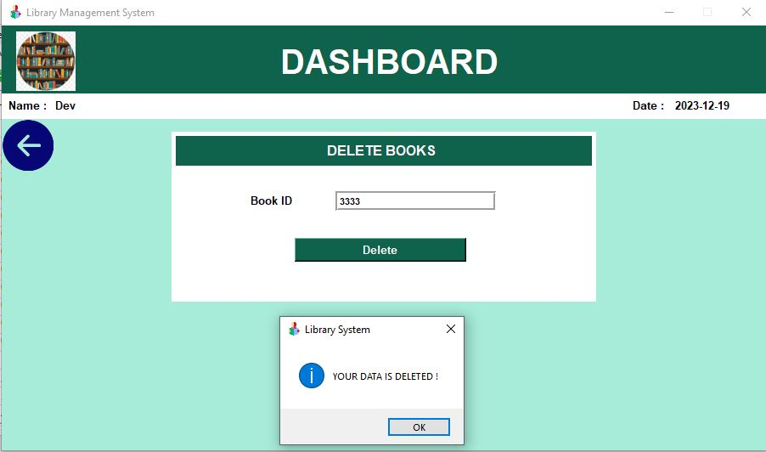
DELETE BOOKS
The delete book function swiftly removes specific books from the library system based on their unique identification, ensuring an organized and accurate catalog management process by eliminating outdated or irrelevant entries.

Slide 15
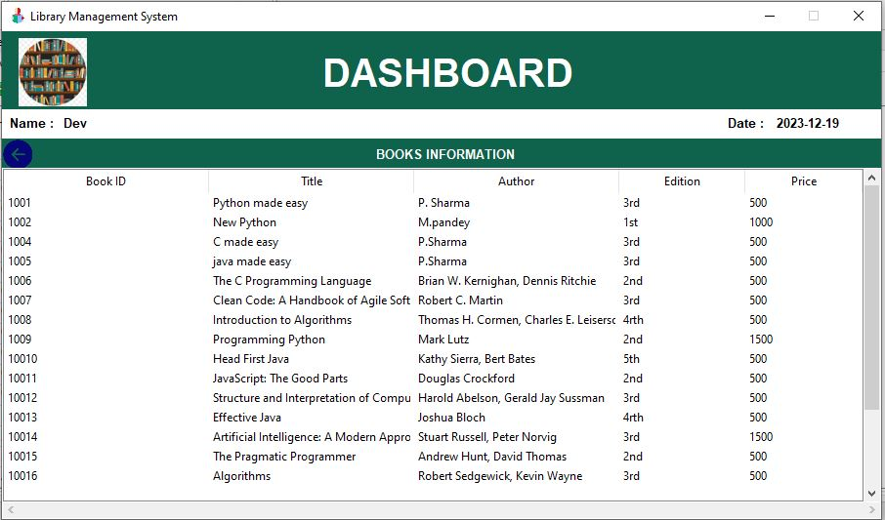
SHOW BOOK
The "Show Books" feature tailored for librarians provides a comprehensive overview of the entire library inventory. It assists librarians in organizing, tracking, and maintaining the library's collection, facilitating streamlined access to detailed information about available books for effective resource management.

Slide 16
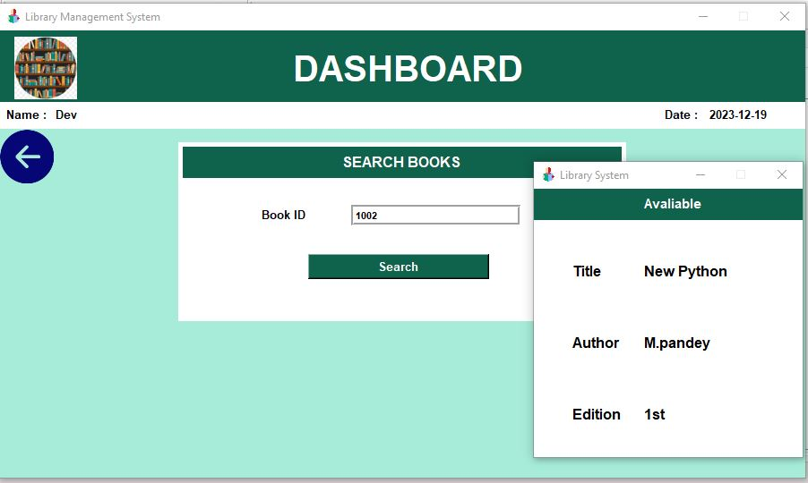
SEARCH BOOK
The "Search Book" function swiftly retrieves specific books by their unique identification number, offering a direct and efficient way for users to locate particular items within the library's collection.

Slide 17

Section 4
SECURITY

Slide 18
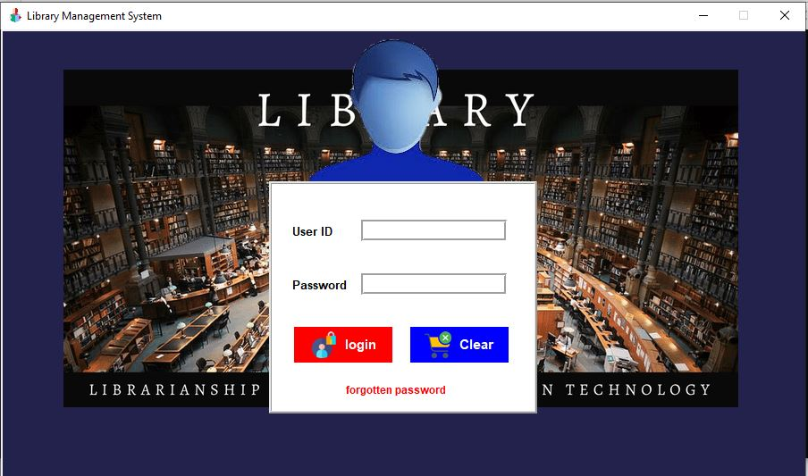
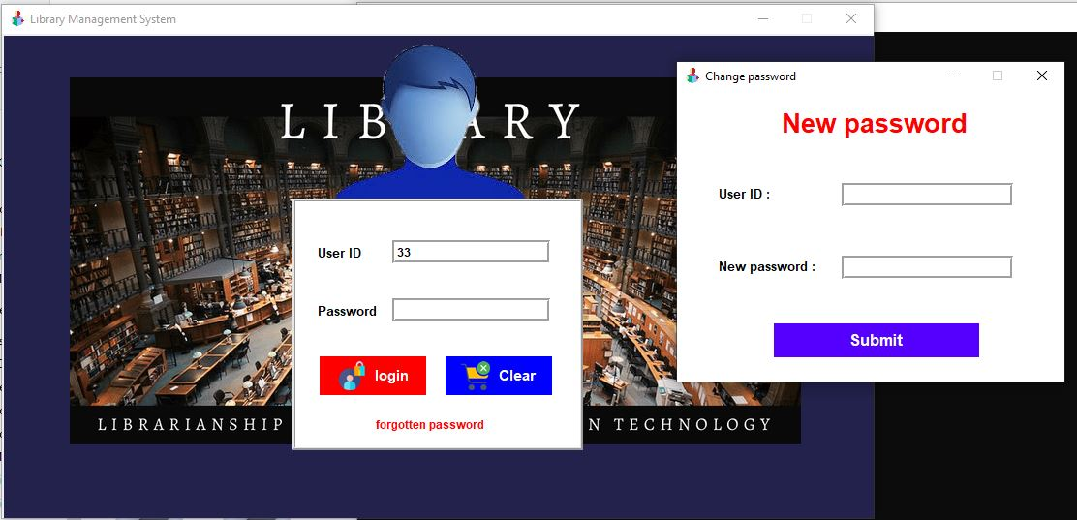
Keeping Things Safe: Access Control in LMS
For added security, the Library Management System has a login setup with username and password fields. Plus, there's a handy "Forgotten Password" option in case you happen to misplace your login details—making sure you're never locked out for too long

Slide 19

Section 5
TECHNOLOGY STACK

Slide 20
Technologies used in making the project
Visual Studio Code (VS Code): Utilized as the Integrated Development Environment (IDE) for coding and project development.
Python: Utilized as the primary programming language for developing the project due to its versatility and ease of use.
Tkinter Library: Integrated Tkinter, a Python library for creating graphical user interfaces (GUIs), to design and implement the project's user interface elements.
SQLite3 Library: Employed SQLite3, a lightweight and efficient SQL database engine, to manage and interact with the project's database within the Python environment.
SQLite Studio: Used SQLite Studio, an external graphical user interface for SQLite, to visually manage, create, and modify the SQLite database schema, tables, queries, and data outside of the Python environment. Its utility lies in providing a more user-friendly interface for database management tasks compared to command-line tools

Slide 21

Section 6
CONCLUSION

Slide 22
Conclusion: Technology's Role in Libraries
In our exploration, we've witnessed technology's profound impact on libraries. Python's Tkinter brought simplicity to our design, while SQLite3 managed our library data efficiently. Tools like Visual Studio Code played a key role in our development process. This journey demonstrates how technology continues to revolutionize libraries, paving the way for more accessible and efficient experiences.

Slide 23
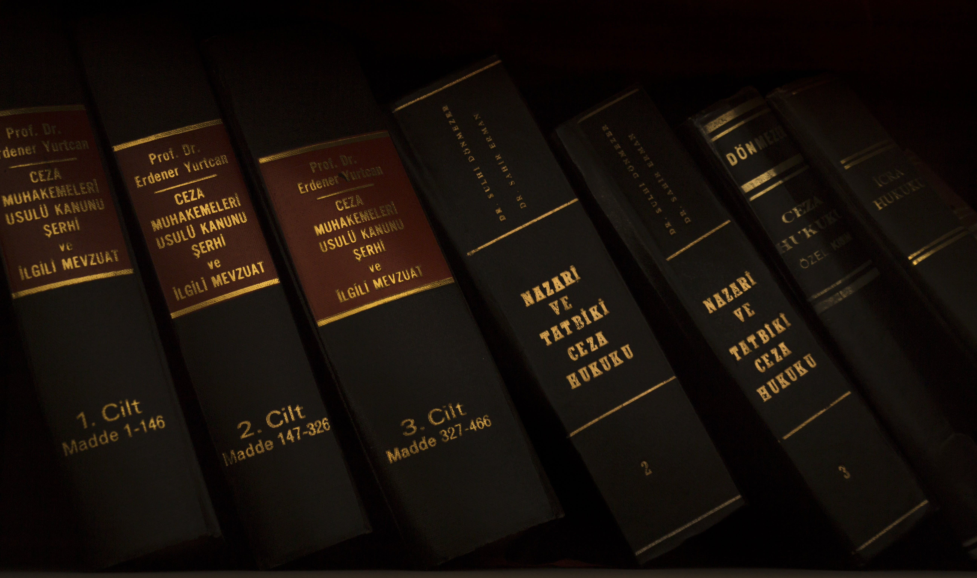
THANK
YOU

